Slide 1
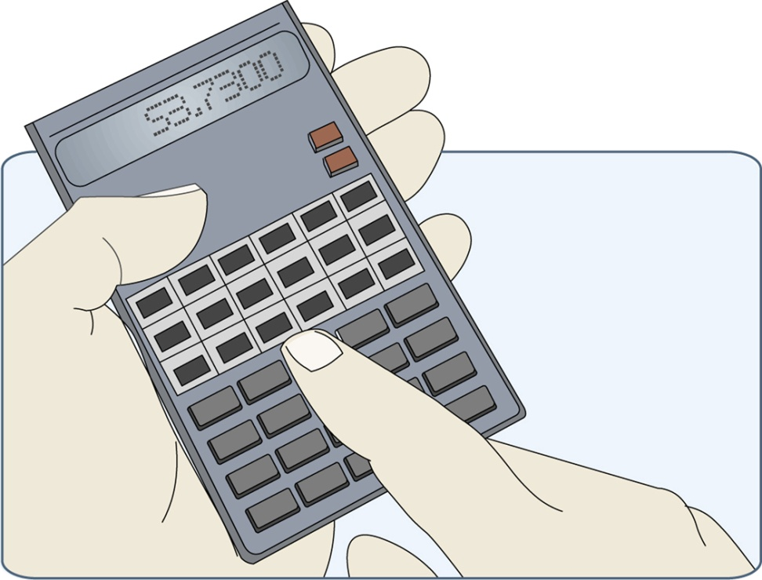
How to do a cable calc
Notes:
Notes here.
____________________________________________
Definitions / Abbreviations:
OSG page number(s)/table(s)/figure(s):
Other publication/document page number(s):
Web page(s):

Slide 2
Steps in a cable calculation
1. determine the design current (Ib). This is the current found using the power formula Ib = P/V
2. find the protective device size (In). This is determined because the cable will have to be capable of carrying the full rating of the fuse. If we only picked a cable capable of carrying the design current, the cable may be liable to overheating
3. determine the current-carrying capacity of the cable (It).
. Apply any correction factors if any, then go to cable tables
4. Check for volt drop to assess the length of run

Slide 3
Step 1
‘Full Load’ Design Current (I_{b}).
The design current can be calculated using the Power Triangle
P = Power of load (watts)
Uo = Nominal Supply voltage (volts)
P
Uo
I
Ib = P
Uo
Notes:
Notes here.
____________________________________________
Definitions / Abbreviations:
OSG page number(s)/table(s)/figure(s):
Other publication/document page number(s):
Web page(s):

Slide 4
Application of Power Triangle.
Example: the LOAD has a power rating of 5000 watts (5 kW) If the mains is 230V, what current is the LOAD drawing ?
I_{b} = P
I_{b} = 5000 (W)
I_{b} = 21.7 Amps
V
230 (V)
NOTE: always change P from killowatts to Watts
Notes:
Notes here.
____________________________________________
Definitions / Abbreviations:
OSG page number(s)/table(s)/figure(s):
Other publication/document page number(s):
Web page(s):

Slide 5
Design Current (Ib)
for 3 phase (3 line)
Ib = ___ P ___
√ 3 x Uo x cos φ
e.g I have a 3 line 3kW motor (power factor corrected)
So 3000/1.73 x 230 = 7.54 A

Slide 6
Step 2
Selection of Protective Device (In).
Once I_{b} (full load design current) is known, the rating of the protective device (I_{n}) can be selected using the rule:
I_{n} ≥ I_{b}
In simple terms, this states that the rating of the protective device (I_{n}) must be greater than or equal to the full load design current (I_{b}) – common sense, otherwise the protective device would ‘nuisance’ trip.
Notes:
Notes here.
____________________________________________
Definitions / Abbreviations:
OSG page number(s)/table(s)/figure(s):
Other publication/document page number(s):
Web page(s):

Slide 7
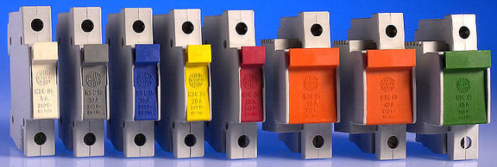
Available fuse’s and colour codes
5A 10A 15A 20A 30A 35A 40A 45A

Slide 8
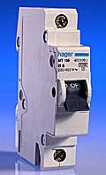
Available circuit breakers
Rarely colour coded
Common sizes are:
6 amp
10 amp
16 amp
20 amp
32 amp
40 amp
45 amp (not common)
50 amp

Slide 9
Order of calculation
1. -Calculate the expected (design) current in the circuit (Ib)
2. -Choose the type and rating of protective device (fuse or circuit breaker) to be used (In)
3. -Divide the protective device rated current by the ambient temperature
----- correction factor (Ca) if ambient temperature differs from 30°C
4. - Further divide by the grouping correction factor (Cg)
5. -Divide again by the thermal insulation correction factor (CI)
6. -Divide by the semi-enclosed fuse factor of 0.725 where applicable
7. -The result is the rated current of the cable required, which must be chosen
----- from the appropriate tables

Slide 10
Top Tip - For device size In
If you cannot remember the sizes look at:
BS7671 tables 41.2, 41.3 & 41.4 on pages 57,58 & 59 the maz Zs tables give devices and sizes
BS7671 App 3 Time/Current charts
On Site Guide pages 120 – 125 similar tables

Slide 11
Top Tip - For device size In
If you cannot remember the sizes look at:
BS7671 tables 41.2, 41.3 & 41.4 on pages 57,58 & 59 the maz Zs tables give devices and sizes
BS7671 App 3 Time/Current charts
On Site Guide pages 120 – 125 similar tables

Slide 12
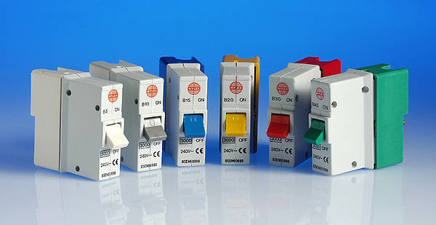
Protective device In (example)
I_{n} ≥ I_{b}
If Ib = 21.7
In = 30A fuse or 32A mcb

Slide 13
Step 3
Current Carrying Capacity It
Without correction factors
The capacity the cable comes from:
Each cable type has a table in Appendix 4 of BS7671 (e.g table 4D5 page 364 for flat PVC twin and earth)
Select the correct column for installation/reference method (e.g method C clipped direct)
If you don’t know the reference method look at table 4A2 (pages 341 – 347)
I_{t} ≥ I_{n}
Notes:
Notes here.
____________________________________________
Definitions / Abbreviations:
OSG page number(s)/table(s)/figure(s):
Other publication/document page number(s):
Web page(s):

Slide 14
Example of It
without correction factors
I have a radial power circuit on a single line 16A MCB, wired in 70°C thermoplastic singles in a wall mounted conduit.
What cable size can I use?
Answer = 1.5mm, It = 17.5A, (from table 4D1A page 356)

Slide 15
Rating Factors (correction) –
where to find them (most are in App 4)
Ca = ambient temperature Tables 4B1 (air temp) and 4B2 (in the ground) page 349
Cc = Factor for cables in the ground 0.9
Cd = buried cables more than 0.7m in depths = specialised
Cf = found on page 333 factor for BS 3036 fuse = 0.725
Cg = grouping factor Tables 4C1 (common installations) 4C2, 4C3 (in the ground) , 4C4, 4C5 (tray and ladder) pages 351 - 354
Ci = cables surrounded by thermal insulation, this is found in Table 52.2 of BS 7671 on page 133 and not in Appendix 4. If 400mm or above then the factor is 0.51
Cs = soil thermal resistivity = specialised
NOTE – can you see the formula?
NOTE – can you see the formula?

Slide 16
Examples of correction factors
My 16A radial from before is now on a 15A BS3036 fuse, and in a 35° boiler house, now calculate It, and chose a light duty MICC cable size to suit (thermoplastic and exposed to touch, method C)
So It = In
(Ca x Cf)
1.5mm, It = 22.24A, Ca = 0.93, Cf =0.725, Iz =23A

Slide 17
Step 4
Volt Drop calculation, (page 338)
Following cable calculation, each circuit must be checked for volt drop.
The voltage drop between the origin of the installation & the load must not exceed;
3% (6.9V at 230V) for lighting circuits at full load current (I_{b}).
5% (11.5V at 230V) for single phase power outlets at full load current (I_{b}).
(mV/A/m) for the particular cable comes from the table following the cable table
L = length in meters
Divide by 1000 to change from mV to volts
Result must be below values above or a bigger cable is needed
Voltage drop = (mV/A/m) x I_{b} x L
1000
Notes:
Notes here.
____________________________________________
Definitions / Abbreviations:
OSG page number(s)/table(s)/figure(s):
Other publication/document page number(s):
Web page(s):

Slide 18
Example volt drop calculation
Do the Volt Drop for the 2.5mm MICC cable from before if the length is 50m and Ib = 15.2A
Vd = 12.92V, too high!, choose next size up
For 4mm vd = 7.6V which is ok
Voltage drop = (mV/A/m) x I_{b} x L
1000

Slide 19
OK lets do some full cable calcs!
Example 1
A power circuit has a 14 kW load fed at 230 V.
The cables are thermosetting 90 ºC singles having copper conductors enclosed in conduit, fixed on a wall and run for a length of 36 m.
Overcurrent protection is provided by a BS 88 fuse. The ambient temperature is 40 ºC and the circuit is grouped with two other of the same/similar size.
What’s the smallest size cable I can use?

Slide 20
Example 2
I have a 230V 2kW lighting circuit. The length is 40 m and the cable is pvc twin and earth (thermoplastic 70 ⁰C), clipped direct (single layer on a wall). Protected by a Type B BS EN 60898 circuit-breaker. The ambient temperature is 30 ºC and the cable passes through thermal insulation for 200 mm (totally surrounded). The cable is grouped with one other cable.
What’s the smallest size cable I can use?

Slide 21
Example 3
Got a 5kW 3 line motor to wire in 70ºC SWA protected by BS3036 fuses, the run is along a perforated cable tray grouped with 6 other cables for 80m.
What’s the smallest size cable I can use?

Slide 22
Example 4
I want to supply a 3 Line compressor 15kW in 90° thermosetting SWA, the run is 35m directly in the ground with one other cable, protected by BS88 fuses.
What’s the smallest size cable I can use?

Slide 23
Example 5
I want to supply a 230V 6kW air-con unit in 70°C thermoplastic SWA, but want to run on a cable ladder alongside 5 other cables for 60m, the devices is a Type C BS EN 60898 circuit-breaker.

